Slide 1
Inclusive Placement Opportunities for Preschoolers: A Systems Approach to Preschool Inclusive Practices
A project of the Virginia Department of Education and the Technical Assistance Centers of Virginia
Notes:
Note to presenter: This module can be changed to reflect the needs of your audience; save the presentation to a location on your computer and make necessary changes.
** Prior to presentation ask participants to bring a sample copy of their class/daily schedule and at least 3 sample IEP goals. They will or can be incorporated in a future activity on a later slide.
This module contains activities to promote participant involvement aimed at improving retention of information presented. To learn more about participant-centered training strategies, please refer to: Pike, R. (2002). Creative teaching techniques handbook: Tips, tactics, and how-tos for delivering effective training (3rd ed.). Amherst, MA: HRD Press. Or visit the Web site at www.bobpikegroup.com.

Slide 2
Module 7:
Embedded Instructional Practices in Early Childhood Programs
Notes:
Today we going to talk about how we can embed goals and objectives into routines throughout the day and provide instruction to students with disabilities within those routines.

Slide 3
Objectives
Define Embedded Instruction
Share a process for how to embed targeted learning objectives
Consider how embedded instruction can be used to take advantage of teachable moments
Notes:
Review the learning objectives and let participants know if they have questions throughout the day to place them in the parking lot (have sticky notes and a large post-it paper so that participants can capture their thoughts/questions).

Slide 4
What does embedded instruction mean to you?
Notes:
Activity: Turn to a shoulder partner and discuss the question above.

Slide 5
What is Embedded Instruction?
“An approach used to promote child engagement, learning, and independence in everyday activities, routines, and transitions.”
Notes:
Ask the participants if any of this description was captured in their discussion.
This is accomplished by identifying times and activities when instructional procedures designed for teaching a child's priority learning targets are implemented in the context of ongoing [naturally-occurring] activities, routines, and transitions in the classroom.
This approach to embedded instruction emphasizes the use of complete learning trials to ensure sufficient, systematic, and intentional learning opportunities are provided in the context of everyday activities, routines, and transitions
Our definition also focuses on identifying the types of instructional procedures that might be used within or across these activities, routines, and transitions.

Slide 6
Benefits of Embedded Instruction
Maximizes children’s motivation by considering their interests and preferences
Provides opportunities to learn and practice important skills in meaningful contexts using authentic materials
Teaches skills to a child in activities alongside all children
(Snyder, et al., 2010)

Slide 7
Difference Between Embedded Instruction and Teachable Moments
Embedded Instruction
Planned
Driven by child’s learning objective
Ensures instruction occurs
Systematic progress monitoring
Teachable Moments
Spontaneous
Driven by “the moment”
Takes advantage of an opportunity
Progress monitoring driven by opportunity
Notes:
Before moving forward, let’s take a quick moment and discuss the difference between embedded instruction and teachable moments. Review the slide.

Slide 8
Key Components of Embedded Instruction
Notes:
Whether we are talking about goals, objectives, or learning targets, we also want them to have some quality characteristics.
Specifically, we want learning targets to be functional, generative and measurable.

Slide 9
What To Teach

Slide 10
Target Learning Objective
Is a statement of observable behavior or skill that a child will learn to do
Based on content that children need to learn to participate meaningfully in everyday activities
Notes:
In order to identify what to teach, we need to identify a target learning objective.
Activity: Talk through what would be good examples of targeted learning objectives for a preschool student. (Give the participants 3 minutes to discuss)
Ask the participants, “How would you determine the target learning objectives?”
If the participants answers do not include the following, then share the information below.
Observe children to identify target behaviors that will help them be more independent
Observe children to identify areas of interest that will support engagement in routines and activities

Slide 11
Identifying Target Learning Objectives
We identify children’s target learning objectives from a variety of sources:
IEP goals
Curriculum/state standards/benchmarks
Family input

Slide 12
Writing Functional Target Learning Objectives
What does functional mean?
Reflect concerns of the family
Are “jargon free”
Address skills and behaviors immediately useful in children’s everyday routines
Are integrated into daily routines
Are evaluated with a logical criterion
Notes:
We have just reviewed how to identify target learning objectives. Before discussing how to embed them into daily routines, we must ensure that the targeted goals are “functional” and can easily be taught within the activities, routines, and transitions of the day.
Target learning objectives need to be written in a functional manner.
There are five characteristics of functional goals:
Reflect concerns of the family
Are “jargon free”
Address skills and behaviors immediately useful in children’s everyday routines
Are integrated into daily routines
Are evaluated with a logical criterion
Refer to the information below for clarity if needed.
Jargon-free implies that the goal uses words that are easily understood. Skills addressed should allow a child to interact with peers and access materials while promoting more independence across his or her daily routine. Skills need to be evaluated with a logical criterion. For example, an objective is to have a child play with her sister after dinner or with a friend at school, sharing play materials (dolls, clothing) and space for at least five minutes, two times for three weeks. The criterion of at least five minutes, two times across three weeks, needs to be a realistic one. It may not be logical to have the criterion be 30 minutes, five times a week over four weeks. This is a high criterion especially if, during assessment, the child is not doing the objective at all or only engaging in play for brief periods.

Slide 13
Examples of Target Learning Objectives
Instead of:
Jared will ambulate 5 feet using a walker with minimal assistance
Kisharra will activate toys
How about this:
Jared will move five steps with his walker to play with the children in a play group two times a day for two weeks
Kisharra will use at least four switches hooked to different toys to play by herself for least five minutes at school
Notes:
Here are a couple examples of jargon free and functional target learning objectives that can be easily embedded within a child’s daily routine.

Slide 14
When To Teach
(Snyder, et al., 2010)

Slide 15
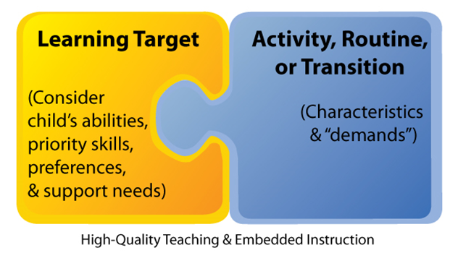
Embedded Instruction
Snyder, P., McLean, M., & Zucker, A., 2015
Notes:
Keep in mind that all children learn when there is some predictability.
When embedding target goals, the team should consider the daily activities, routines, and transitions.
Placeholder Reference information: http://cde.videossc.com/archives/121615/Linking-DRDP-Curricula-and-Embedded-Instruction_December-2015.pdf

Slide 16
Activities Routines Transitions
Notes:
Moving forward we will discover the ART (Activities, Routines, Transitions) of how to embed the target goals and objectives throughout the day.
Decide on handouts and matrices that are found in the handout section of this modules
Note: Additional samples can be found in the Building Blocks for Teaching Preschoolers with Special Needs (2nd ed.) by Sandall & Schwartz (Baltimore, MD: Paul H. Brookes).

Slide 17
Key Considerations
Select which activities, routines, and transitions are logical and appropriate for addressing the target goals/objectives
Plan which and how many instructional learning trials to embed within and across activities, routines, and transitions
Develop an activity matrix to record when you plan to embed instructional learning trials for individual children
Notes:
Here are some key considerations when developing a plan for embedding instruction.
Over the next few slides we will discuss these considerations in more depth.
Placeholder Reference information: http://cde.videossc.com/archives/121615/Linking-DRDP-Curricula-and-Embedded-Instruction_December-2015.pdf

Slide 18
With a partner or in a small group, write down examples of typical preschool activities and routines (things you do every day).
Notes:
Activity: Give the participants three minutes to develop a list of daily activities and routines within a preschool classroom.
Ask a few pairs/groups to report out. If their lists do not include the following, please review.
Arrival
Departure
Snack/meals
Centers/Work time
Toileting
Hand washing
Large/Small group
Transitions
Gross motor/outside time

Slide 19
Selecting Routines
Does the objective naturally fit into the routines of the day?
Will performing the skill lead to more independence within the routine?
Is the routine where most children will be performing the task independently?
Notes:
Consider the list of daily routines you just created and reflect on the following questions.
Select one or two routines/times of the day to teach each objective by answering “yes” to the following:
Does the objective naturally fit into the performance of the routine or planned activity? Is it frequently required in the routine? Will it help the student be more actively involved in the routine?
Will performance of the objective make the child more independent within the routine?
If the child requires physical assistance to participate, is the routine fairly easy for most of the students in the group to perform independently?
Remember that children with disabilities learn quicker and remember longer if objectives are taught in several environments as well as their natural routines.

Slide 20
Let’s Practice (Activity 1)
IEP goal:
During routine classroom activities, Mia will use three word phrases to make requests or comments. Mia will use three word phrases six times during a language sample collected over two data collection days.
Notes:
Activity: Read the slide, turn to your shoulder partner, and brainstorm times when this could be embedded in the routines and activities of the day.

Slide 21
Target Activities, Routines, and Transitions
Free play
Snack
Centers
Lunch
Notes:
Review these routines of the day, as plausible and best times of the day to work on Mia’s target learning objectives.
Now that we have discussed daily routines and targeted goals/objectives, let’s discuss how to systematically address all of a student’s objectives at a glance using an Activity Matrix.

Slide 22
Benefits of Using an Activity Matrix
It helps ensure that teaching occurs in a meaningful and authentic way
It puts target learning objectives front and center for teachers and families
It plans a time in the daily routine to teach target learning objectives
Notes:
Review the points on the slide.
Things to think about for a well-planned activity matrix:
Match the child’s learning objective to the activity
Consider natural locations in which the behavior occurs
Use staff who are available during daily activities
Identify the number of opportunities needed for practice

Slide 23
Activity Matrix
 | Mia | Matthew
Arrival
Free play
Circle
Outside
Snack
Class activity
Departure
Transitions
Step 1:
List the activities and times of day in the left hand column of the chart
Step 2:
Create columns to the right for each child
Notes:
Here is one example of an activity matrix which shows more than one child at a time and their targeted learning objectives.
You have additional examples in your handouts that accompany this module.

Slide 24
Activity Matrix For Mia
Target Learning Objective | Mia will use one to two words to express her needs and wants
Arrival | Use one to two words to express her needs/wants
Free Play | Verbally name at least three different colors
Circle | Imitate at least one action performed by a peer
Outside | Imitate at least one action performed by a peer
Snack | Use one to two words to express needs/wants
Transitions | Verbally name at least three different colors
Notes:
This is an example of a single child’s activity matrix.
The target instructional learning objectives have been embedded into the Activities, Routines, and Transitions of Mia’s preschool day.

Slide 25
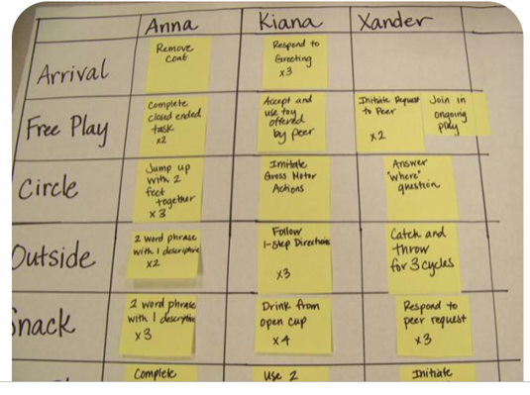
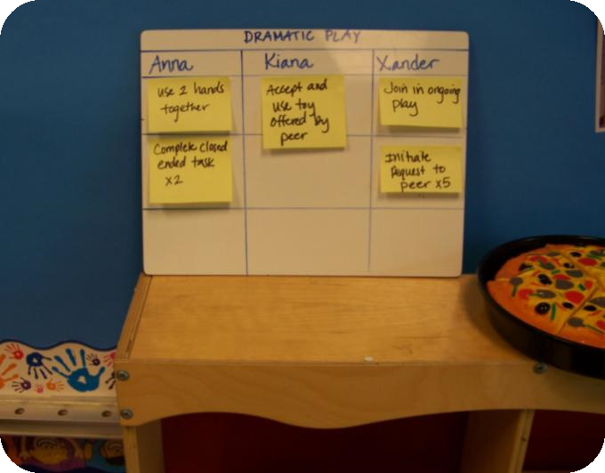
Classroom Activity Matrix
Specific Area Classroom Matrix
Notes:
Here are two examples:
A classroom activity targets the daily activities, routines, and transitions of the day.
The activity matrix placed in the house corner allows the team to target objectives specifically within that designated area.
Using post-it notes on the matrix is a convenient way of organizing. Learning targets can be written on the notes and placed around the classroom. This is a nice portable method. The post-it notes can move daily as the teachers assess the best activities in which to teach these skills.

Slide 26
How To Teach
Notes:
The third component is how to teach – determining which teaching strategy is most appropriate to address the target instructional goals and objectives.

Slide 27
Tier 1 Strategies
Environmental Accommodations
Adapt Schedule
Adapt Materials and Toys
Adapt Requirements or Instructions
Notes:
Before we share some specific strategies for teaching a child, let’s look at some overall Tier 1 strategies that can work for all children.
These include environmental accommodations, adapting the schedule, adapting materials, and adapting requirements/instruction.

Slide 28
Strategies To Make Environmental Accommodations
Look at the set up of the environment:
Adequate space to move freely
Ensure access to materials
Classroom arranged in “zones”
Notes:
The environment can be modified as needed to promote more participation. Some examples of modifications to the environment include:
Situation – Children have difficulty putting toys or materials away
Modification – Label the shelves or containers with pictures or symbols
Situation – Children are running throughout the classroom
Modification – Have well-defined centers that use furniture and shelves to create spaces, taking away large open areas that allow running
Situation – A child is unable to maintain his or her materials in front of self while working
Modification – Put materials in a shallow tray that defines the area for the child
Transitions: A structured approach, such as zone defense scheduling (refer to handouts) (McWilliam, 2005), a method for organizing adults and the physical environment during classroom transitions. Transitions are typically challenging times for children, especially for those with disabilities. The basic premise behind zone defense scheduling is for classroom staff to “zone” or man areas of the room instead of individual children. A schedule is created indicating when certain classroom staff would be in certain areas of the classroom taking their places at the beginning of transitions.
***Additional resources and supports around environmental design can be found in the Setting Up the Environment module.
***Ask Mary about the handouts referred to above.

Slide 29
Strategies To Adapt The Classroom Schedule
Posted daily schedule at the students’ eye level
Refer to the schedule throughout the school day
Pair the symbol with corresponding verbal directions
Use visual symbol and verbal cue to indicate a change activities
Use mini-schedules to show the actions associated with routines (ex., handwashing, lining up)
Notes:
https://tats.ucf.edu/wp-content/uploads/sites/9/2018/12/ongoing-document-all-sections.pdf

Slide 30
Strategies To Adapt Activities
Simplify a task by breaking it into smaller parts:
Break the tasks into more manageable parts
Change or reduce the number of required steps
Break down a complicated task into its parts
CONNECT Video 1.9 Routine in a program block play
Notes:
Video: CONNECT Embedded instruction evidence 1.9 block play (link on slide) https://youtu.be/NqxXdmT82iQ
Break down the task. Have the situation on flip charts
Situation – When playing with toys, puzzles, or beads, the child is distracted by the pieces and often drops, bangs, or scatters the pieces rather than try to put the pieces in the puzzle frame.
Modification – Hand the pieces to the child one by one, gradually increasing the number of pieces the child has at one time.
Situation – A child is overwhelmed by activities such as cooking, crafts, or table games.
Modification – Break down the activity into several parts. Describe the parts in clear terms. Draw pictures of the steps to make it even clearer.
Change or reduce the number of required steps.
Situation – A child plays repetitively in the house corner and rarely acts out multistep scenes.
Modification – Make photographs of three- or four-step play scenes (e.g., put the pot on the stove, take it to the table). Use the photos to help the child lengthen the time spent in play.

Slide 31
Strategies To Adapt Materials
Modify the materials so children can participate as independently as possible:
Put materials at the optimal level
Stabilize materials using tape, Velcro, etc.
Modify the response required
Make the materials larger or brighter
CONNECT Video 1.6 Routine in a program reading at circle time
Notes:
Video: CONNECT Module video 1.16 child in group reading at circle time (link on slide) https://youtu.be/zHGFQOoMcKw
Examples of modifications to materials.
Put materials at the optimal level.
Situation – Child has to reach up to the counter to put away dishes and utensils at snack time.
Modification – Place plastic wash tubs on child-size chairs or benches for clean up.
Situation – Child has difficulty standing and using the art easel.
Modification – Lower the easel and give the child a chair or make a table-top easel.
Stabilize materials.
Situation – A child’s movements make the art slide off the table.
Modification – Tape the paper to the table.
Situation – A child has trouble using one hand to hold a toy, such as a jack-in-the-box or hammering toy, and the toy falls over when the child tries to use it.
Modification – Use clamps or Velcro to attach the toy to a hard surface.
Modify the response.
Situation – The child has difficulty turning pages of a book.
Modification – Create page fluffers by gluing a small piece of Styrofoam to the pages, making it easier to turn.
Situation – A child does not choose the art center because activities such as gluing and pasting are too hard.
Modification – Use contact paper as the backing for collages. The child only has to apply them to the paper and they will stick.
Make the materials larger or brighter
Situation – Child shows little interest in using paper for art.
Modification – Include shiny pieces of Mylar or other shiny paper in the collage box.
Situation – A child shows little interest in a book during story time.
Modification – Use a “big book” or talking books.
Situation – A child is visually impaired.
Modification – Use high-contrast colors.

Slide 32
Strategies To Adapt Instruction
Have another child help –peer assistance
Have the child do something different within the same activity
Have an adult help a child do the activity
Low – high tech options
Notes:
Activity: Share a blank copy of the classroom activity matrix and an individual child matrix (located in module handouts).
In teaching teams, review the sample classroom schedules you brought, and the sample IEP goals, and plug into each of the matrices.
If the participants do not come prepared with a sample schedule or IEP goals refer to the handouts in this module.
After completing, ask for volunteers to share where they placed goals and why.

Slide 33
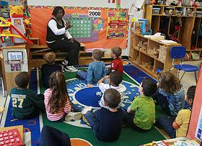
Next Step
Notes:
Now that you have developed some matrices, written functional goals and objectives, determined what routines will be used to teach the objectives, and enhanced the environment to facilitate children’s participation and learning, let’s discuss how teachers provide specific instructional supports by using a planned instructional sequence.

Slide 34
What is Planned Instructional Sequence?
Short teaching interactions used to teach a child a skill
Can be used to teach any skill
Fits into ongoing classroom activities, routines, and transitions
Notes:
What is a Planned Instructional Sequence? It's a series of short teaching interactions that utilize research-proven techniques to provide instruction.
It can be used to teach any skill including communication, cognitive motor, and social skills.
Planned Instructional Sequence involves a specific sequence to initiate and follow up on teaching interactions.
This material was developed by the Head Start Center for Inclusion with federal funds from the U.S. Department of Health and Human Services, Office of Head Start (Grant No. 90YD0270).

Slide 35
4 Step Process
Cue
Provide help if needed
Child response
Feedback
Notes:
Planned Instructional Sequence is a 4 step process. It’s essential that the teacher plans ahead to teach a specific skill. S/he carefully identifies and plans for each of the following steps (the steps are also outlined in the handout, Teacher’s Guide to Embedded Learning Opportunities).
First a cue (or what you might sometimes hear called an “antecedent”) is provided to get the process started. These are often verbal cues (or something the teacher says), but children can also be cued by the environment, an activity, or even peers.
Next, the teacher will provide help if the child needs it. This is the teaching part and is extremely important, especially in the beginning learning stages of a new skill.
The third step is the child response (or child behavior). The teacher will provide enough time for the child to respond after either the cue or after the help.
Lastly, the teacher will provide feedback (or a consequence) depending on the child’s response. Correct and incorrect responses will elicit different feedback.
This material was developed by the Head Start Center for Inclusion with federal funds from the U.S. Department of Health and Human Services, Office of Head Start (Grant No. 90YD0270).

Slide 36
Learning Objective: Mia will use 1-2 words to express her needs and wants.
Cue
What will the teacher say or do?
Child Response
What will Mia do?
Feedback
How will the teacher respond?
Provide Mia with help to open the container and praise her for asking.
Provide a container with lid still on.
Mia will say “Help.”
Notes:
Let’s look at an example of a Planned Instructional Sequence for Mia. Mia’s team planned for her instruction on a learning objective during a small group activity.
Remember her learning objective stated, “Mia will use 1 to 2 words to express her needs or wants.”
The teacher wants Mia to ask for help, so she provided something in the environment that would set the occasion or cue Mia to ask for help. As a cue, Mia’s teacher gave her a playdough container with the lid still on. The behavior or desired child response is that Mia will say “help.” After Mia says help, the teacher will provide her with assistance to open the container and give her praise for asking for help. This is the consequence or feedback linked to Mia’s objective behavior.
This material was developed by the Head Start Center for Inclusion with federal funds from the U.S. Department of Health and Human Services, Office of Head Start (Grant No. 90YD0270).

Slide 37
How To Evaluate
(Snyder, et al., 2010)

Slide 38
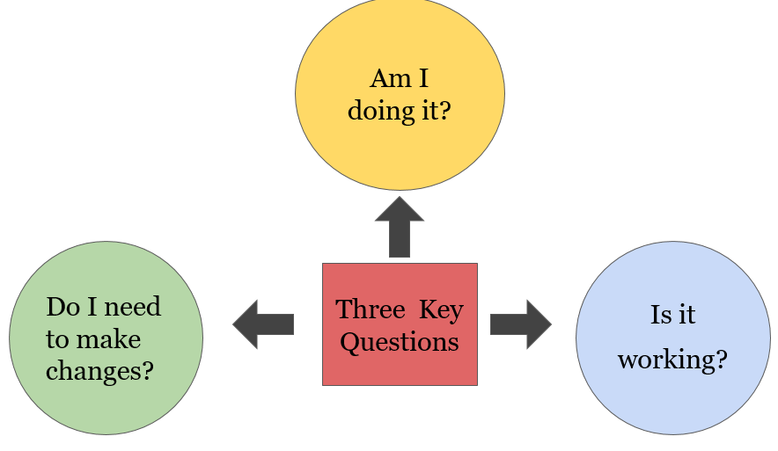
Key Questions
Notes:
Let’s focus on three key questions to ask when evaluating embedded learning opportunities.
When evaluating, we ask:
Am I doing it? Implementation of embedded learning targets
Is it working? Monitoring child progress (data collection)
Do I need to make changes? Continue or revise the target learning objective and instructional plan.
Taken together, these questions provide a framework for data-based decision making.

Slide 39
How Do You Evaluate Progress?
Anecdotal notes
Running records
Teacher reflections
Checklist or inventories
Data (frequency/duration/% time/intensity/% opportunities)
Other progress monitoring forms
Notes:
Evaluating and/or monitoring progress can be accomplished a variety of ways.
Additional information pertaining to progress monitoring including sample data collection tools can be found in module 9.

Slide 40
Let’s Review
Embedded learning opportunities promote engagement while addressing functional target learning goals and objectives
Use an activity matrix to select routines and plan when the objectives will be addressed throughout the day
Embedded learning opportunities require a systematic approach to planning instruction
Evaluating is key to data-based decision making
Notes:
To wrap up today, let’s review why embedded learning opportunities are essential within early learning settings for young children with disabilities.
Embedded learning opportunities help to meet a child’s individualized learning needs with respect to their everyday routines and activities.
Embedded learning opportunities maximize children’s motivation by considering their interests and preferences. Teachers, parents, and other team members work together to identify child interests and preferences.
Embedded learning opportunities provide opportunities for children to learn and practice important skills in meaningful contexts. Children learn and master skills in contexts where these skills are needed.
Research has shown that all young children benefit from high quality learning opportunities. For children with disabilities, it is particularly important to provide sufficient learning opportunities to promote and advance their learning and development.

Slide 41
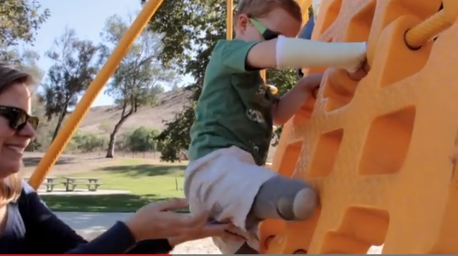
Let’s Practice (Activity 2)
Notes:
Note: Use the scenarios from Building Blocks for Teaching Preschoolers with Special Needs (Sandall & Schwartz) or conduct the following activity.
Activity: Divide participants into four groups: materials, environment, schedule, and activities. Provide the following situations to each group by typing the situations or posting them on flip charts for each group. Ask each group to brainstorm at least one or two modifications that fall into their areas. Allow 10 minutes for groups to report out. Fill in with suggestions below if they were not mentioned by the groups.
Physical environment:
Situation – A child pulls things off the toy shelves and then plays in front of the shelves blocking other children’s access.
Modification – Put tape on the area in front of the shelf. Remind children that they must play with the toys outside the taped areas.
Situation – A child has difficulty keeping his or her hands to him or herself when working on individual activities or projects.
Modification – Provide an individual workspace by using trays, box lids, or placemats.
Situation – A child has difficulty with putting toys and equipment away.
Modification – Use pictures or symbols on shelves and containers. Make cleaning up a match game.
Situation – A child does not participate in learning centers.
Modification – Create a picture schedule for the child. The picture schedule can have pictures or symbols representing the various learning centers organized in a certain order (e.g., art first, dramatic play second, etc.).
Materials:
Situation – A child has trouble using one hand to hold a toy, such as a jack-in-the-box or hammering toy, and toys fall over when the child tries to use them.
Modification – Use clamps or Velcro to attach the toy to a hard surface.
Situation – A child seems to slip and slide on the wooden chairs in the classroom.
Modification – Attach a section of bathmat or bathtub appliqués to the seat.
Situation – A child does not chose the art center because actions such as gluing and pasting are too difficult.
Modification – Use contact paper or other sticky paper as the backing for collages. Then child will only have to put things on the paper.
Activities:
Situation – A child is overwhelmed by activities, such as cooking projects, craft projects and table games, and is rarely successful.
Modification – Break down the activity into several parts. Describe the steps in clear terms. Draw pictures of the steps to make it even clearer.
Situation – When playing with manipulative toys, such as puzzles and beads, a child is easily distracted by the pieces and often drops, bangs, or scatters the pieces rather than trying to put the pieces in puzzle frame.
Modification – Hand the pieces to the child one by one. Gradually increase the number of pieces the child has at one time.
Situation – The soap dispenser is on the wall and requires that the child reach across the sink and make an upward motion with the hand; because of the distance, the child can barely reach or needs to stand on tiptoes.
Modification – Use a plastic bottle with a pump top as a soap dispenser. Place it on the counter or attach it to the sink with a suction cup.
Schedule:
Situation – A child needs practice staying at circle time.
Modification – Rotate between active activities, such as songs with motions, and more passive activities, such as listening to stories within the circle activity.
Campbell, P.H., Milbourne, S.A., & Kennedy, A.A. (2012). Cara’s kit for toddlers: Creating adaptations for routines and activities. Baltimore, MD: Paul H. Brookes.

Slide 42
References, Slide 1
Division for Early Childhood. (2017). DEC recommended practices in early intervention/early childhood special education 2014. (Retrieved from http://.dec-spd.org/recomendedpractices)
Rock your classroom: Evidence-based practices for early childhood classrooms. Observation guide professional development tool. Orlando, FL: University of Central Florida Technical Assistance and Training System. (Retrieved from
https://tats.ucf.edu/wp-content/uploads/sites/9/2018/12/ongoing-document-all-sections.pdf)
Sandall, S.R., & Schwartz, I.S. (2014). Building blocks for teaching preschoolers with special needs (2nd ed). Baltimore, MD: Paul H. Brookes.
Notes:
Information and opinions expressed in this module are those of the authors.
Permission to use and adapt these materials has been granted to the Virginia Department of Education’s Training and Technical Assistance Center at Virginia Commonwealth University.

Slide 43
References, Slide 2
Schwartz, I.S. (2014). Using the Building Blocks approach to meet the needs of young children with autism and related disorders. (Retrieved from https://inclusioninstitute.fpg.unc.edu/sites/inclusioninstitute.fpg.unc.edu/files/handouts/UNC%202014%20BB.ppt)
Snyder, P., McLaughlin, T., Hemmeter, M.L., McLean, M., & Sandall, S. (2010). Intentional and systematic instruction in early intervention: Tools for teachers and families. Pre-conference workshop presented at the International Division for Early Childhood Conference, Kansas City, MO.
Snyder, P., McLean, M., & Zucker, A. (2015). Linking the DRDP 2015, Curricula, and Embedded Instruction. Gainesville, FL: University of Florida, Center for Excellence in Early Childhood Studies.

Slide 44
Resources
CONNECT Modules, http://community.fpg.unc.edu/
Head Start Center for Inclusion, http://headstartinclusion.org/

Slide 45
Thank You!
If you have any questions about the content in this module or need further assistance implementing a systems approach to early childhood inclusive practices, please contact the early childhood staff at the following T/TACs.
Regions 1 & 8 VCU 804-828-6947 or 434-292-3723
Regions 2 & 3 ODU 757-683-4333
Region 4 GMU 703-993-4496
Region 5 JMU 540-568-6746
Regions 6 & 7 VT 540-231-5167

